Slide 1
Online Shoppers Purchasing Intention Prediction USING svm and mlp
Presented By: M.VIJAYAKUMAR – III Year, K.V.C.E.T
NM ID:
Email ID:

Slide 2
TABLE OF CONTENTS:
Introduction
Problem Statement
Data Collection
Technology Used
Library Used
Output

Slide 3
INTRODUCTION:
Online Shoppers Purchasing Intention Prediction using SVM and MLP refers to using machine learning techniques, specifically Support Vector Machines (SVM) and Multilayer Perceptrons (MLP), to predict whether online shoppers will complete a purchase. This task falls within the realm of classification problems in machine learning where the goal is to predict a binary outcome: purchasing or not purchasing.

Slide 4
PROBLEM STATEMENT:
The goal of this project is to develop a predictive model using Support Vector Machines (SVM) and Multilayer Perceptrons (MLP), which are sophisticated algorithms capable of classifying shoppers into those who will make a purchase and those who will not based on their session data.
This model aims to aid e-commerce companies in identifying potential buyers and understanding key factors that drive purchasing decisions, thereby allowing for more effective allocation of marketing resources and personalized customer engagement.

Slide 5
TESTING TECHNOLOGIES:
Anaconda Python)
Anaconda is a free and open-source distribution of the Python and R programming languages for scientific computing, that aims to simplify package management and deployment.
Jupyter Notebook
The Jupyter Notebook is an open-source web application that allows you to create and share documents that contain live code, equations, visualizations and narrative text. Uses include: data cleaning and transformation, numerical simulation, statistical modeling, data visualization, machine learning, and much more.

Slide 6
DATA COLLECTION:
Data collection is the process of gathering and measuring information from countless different sources. In order to use the data we collect to develop practical artificial intelligence (AI) and machine learning solutions, it must be collected and stored in a way that makes sense for the business problem at hand.
Data has to be collected from KAGGLE.

Slide 7
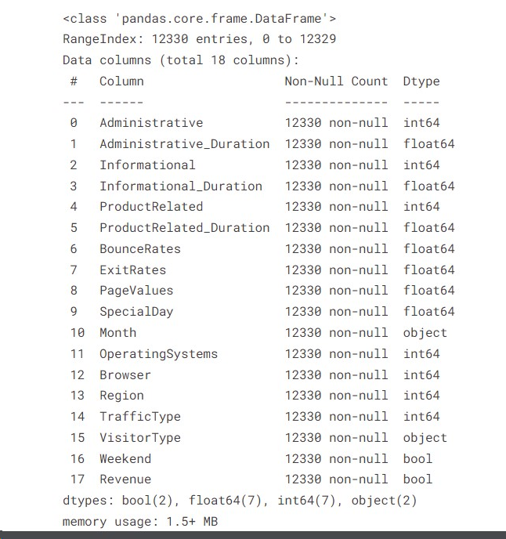

Slide 8
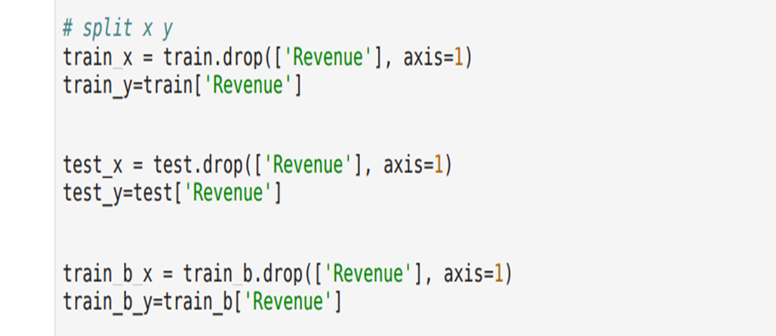
TRAINING AND TESTING:
Data preprocessing
Splitting datasets
Model training
Hyperparameter tuning
Validation
Error analysis
Final prediction

Slide 9
LIBRARIES USED:
Pandas - Pandas is a software library written for the Python programming language for data manipulation and analysis. In particular, it offers data structures and operations for manipulating numerical tables and time series.
Sklearn - Scikit-learn is a free software machine learning library for the Python programming language. It features various classification, regression and clustering algorithms including support-vector machines.

Slide 10
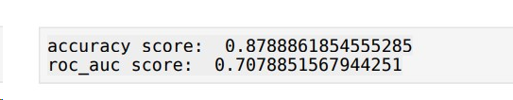
OUTPUT:

